Slide 1

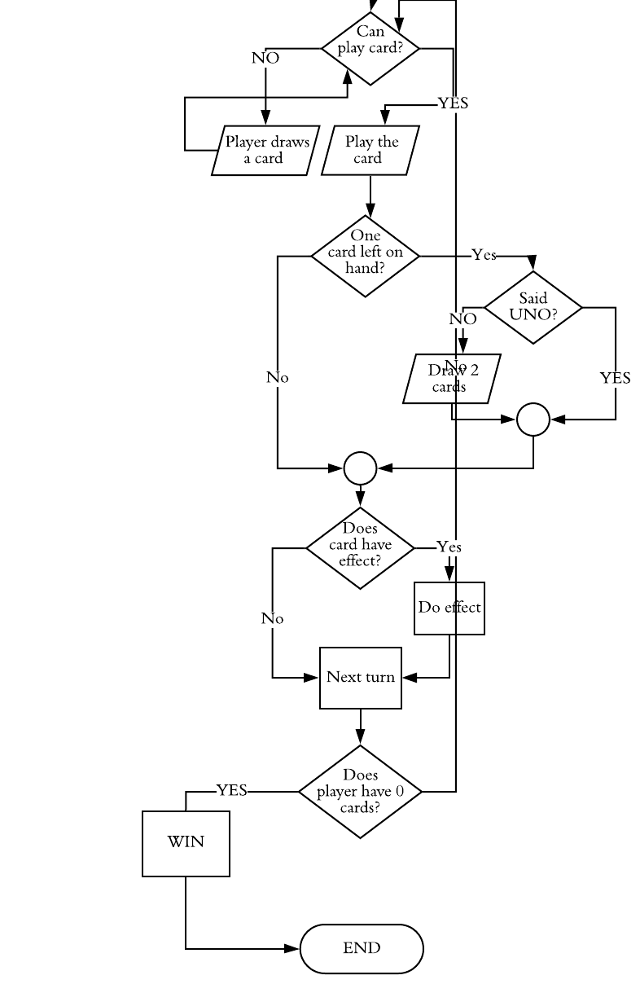
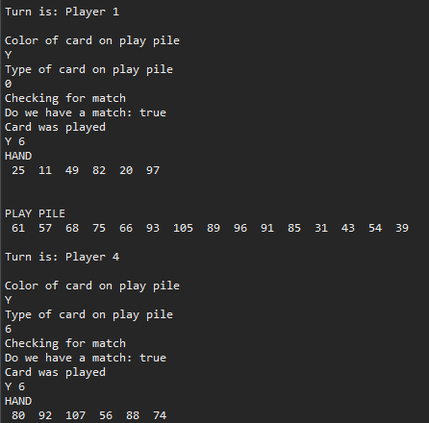
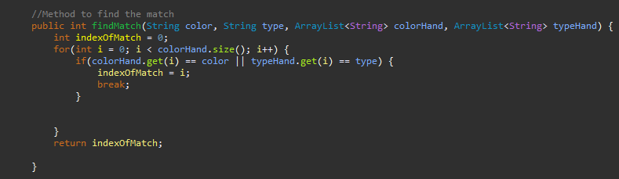
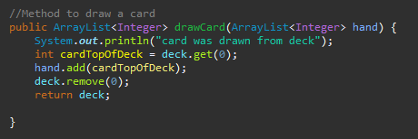
Java I Final Project: UNO Game
Ana Sanchez | Glenda Dilts | Grand Canyon University
Problem
Design Decisions
Flowchart & Game Logic
Create a program where four CPU players play UNO and implement Object-Oriented programming.
Part of Game | Used
Overall Deck | Int Array List
Play Pile | Int Array List
Player Turn/Turn Mechanism | String Array
Determine Color of Uno Card | String Array
Determining Type of Uno Card | String Array
Hands | Int Array List
Action Plan
Implementation Process by Milestone
Create four main classes to keep our game properties and game logic organized. UnoHands, UnoCards, UnoDecks, and driver program UnoGame. Keep the properties within the classes private and then make a setter and getter for each property. Use the UnoGame class as the class for the game logic and flow.
Milestone 1-2
Planning
Flowchart
Storyboard
ADT: classes and methods
Milestone 3
Test Program
Initial program that initialized deck and dealt hands
Milestone 4
Implementation
Implemented match and draw methods,
Refined flowchart
Milestone 5
Final Application
Fixed bugs
Added turn mechanism
Added special card methods
Project Overview
-Start with a main deck (Int ArrayList) that is initialized with integers from 1 to 108
-From there shuffle the main deck
-Deal 7 cards to each players Int ArrayList hand
-Set one card (top card) from the deck to the play pile deck that is an ArrayList
Main matching mechanism by looping through the player hand ArrayList and determine if it contains any of the same color or type
Sample Code
Output/ UI
Method to find the match
Classes
Class to keep track of the properties of each individual Uno Card
unoDecks
Class to keep the properties of the two main decks of the game, overall deck and play pile
unoHands
Class to keep the properties for the player hands
unoCards
unoGame
Determines color and type of cards
Determines if there is a match between card on play pile and player hand
Finds the match
Keeps track of the turns
Keeps track if we are in reverse or not
Methods to draw & play cards
Methods for actions for specials cards, ex draw 2, WILD
Methods to set and get hand
Method to deal hands in game preparation
Testing purposes methods such as printing hands and getting size of hands
Driver class for the game
Contains the game logic
Contains the flow for the player turns
Creates new instances of the unoHand class for each player
Creates new instance for the game decks
Method to draw card if match
Notes:
To change this poster, replace our sample content with your own. Or, if you'd rather start from a clean slate, press the New Slide button on the Home tab to insert a new page. Now enter your text and pictures in the empty placeholders. If you need more placeholders for titles, subtitles or body text, copy any of the existing placeholders, then drag the new one into place.

